Slide 1
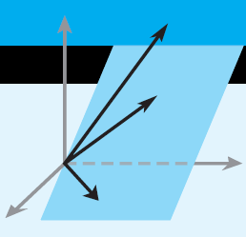
Elementary Linear Algebra
Howard Anton
Copyright © 2010 by John Wiley & Sons, Inc.
All rights reserved.
Chapter 9
Notes:
*

Slide 2
Chapter 9
Numerical Methods
9.1 LU-Decompositions
9.2 The Power Method
9.5 Singular Value Decomposition
Notes:
*

Slide 3
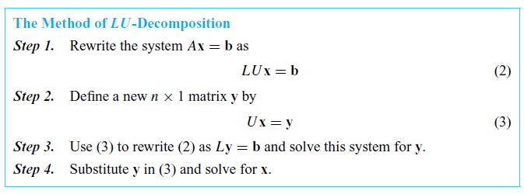

Section 9.1 LU-Decompositions
Notes:
*

Slide 4


Finding LU-Decompositions
Notes:
*

Slide 5
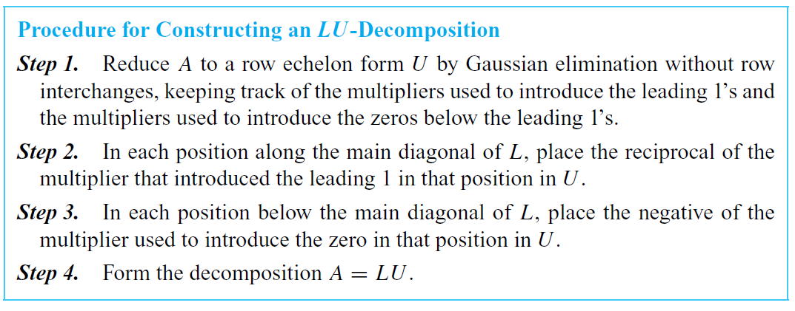
Constructing an LU-Decomposition
Notes:
*

Slide 6

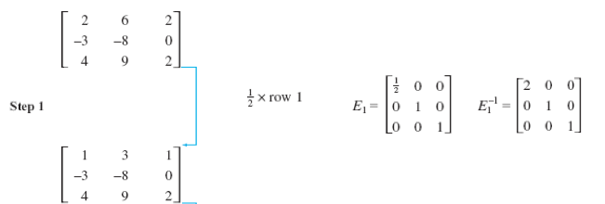

Slide 7




Slide 8

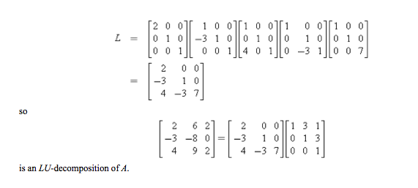

Slide 9
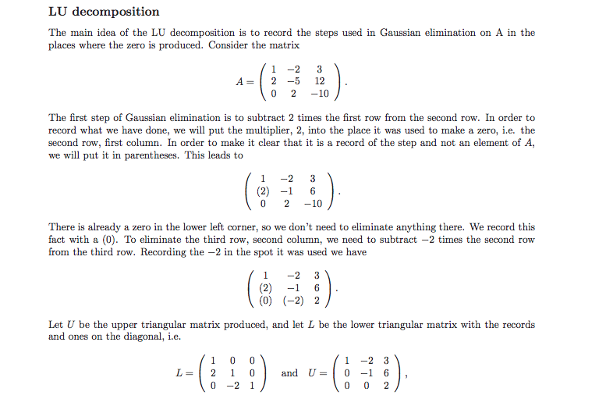

Slide 10


Slide 11

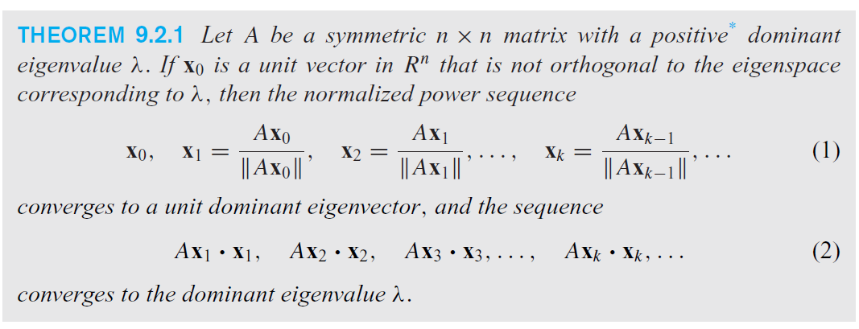
Section 9.2 The Power Method
Notes:
*

Slide 12
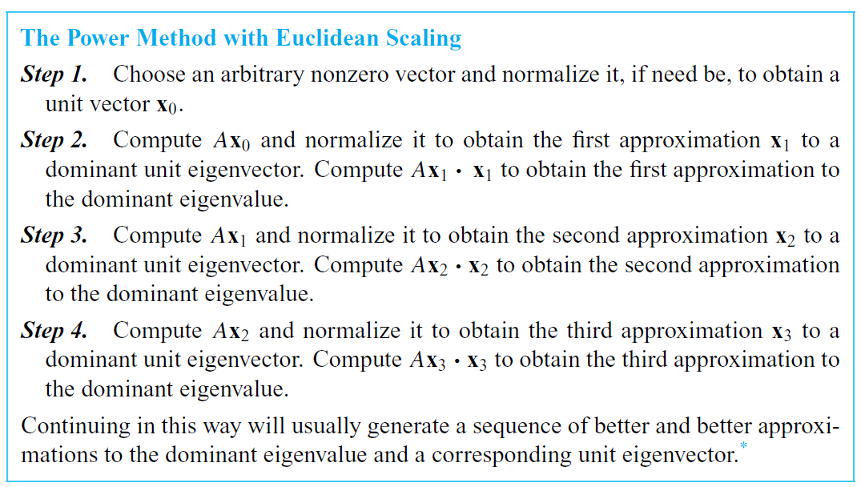
The Power Method with Euclidean Scaling
Notes:
*

Slide 13
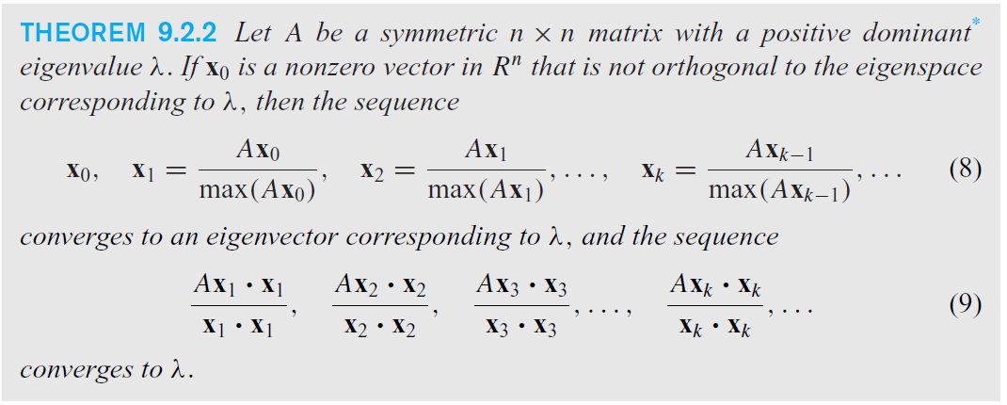
Positive Dominant Eigenvalue, λ
Notes:
*

Slide 14
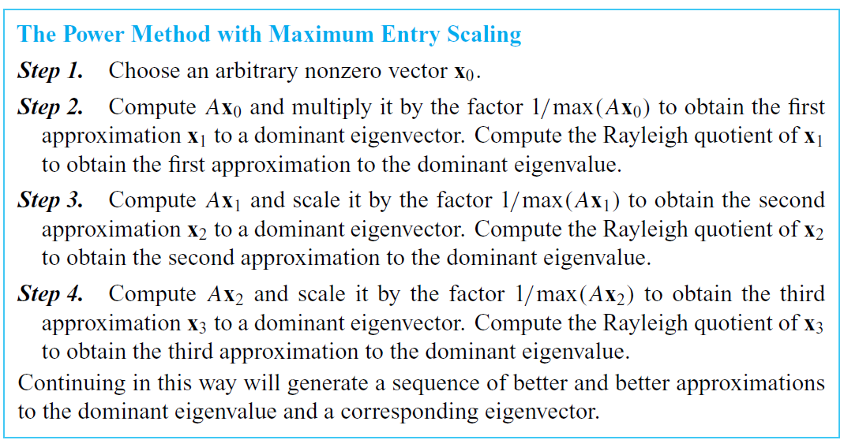
The Power Method
Notes:
*

Slide 15



Slide 16
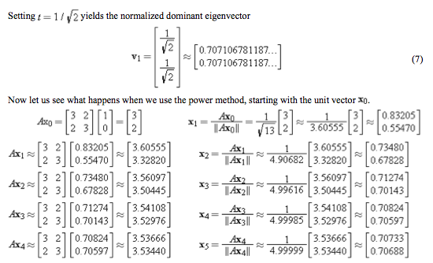

Slide 17
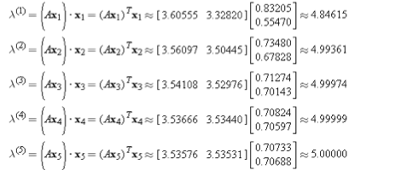


Slide 18


Section 9.5 Singular Value Decomposition
Notes:
*

Slide 19

Singular Value Decomposition
Notes:
*

Slide 20
